Slide 1
Chess Game
Group 3: Ethan Kline, victor Ipinmoroti, Megan Keleman, Matthew nathal

Slide 2
Specifications of the Chess Game
Chess game that can highlight legal moves.
Player against Player (turn based).
Can promote pawn pieces .
Can castle.
Can highlight piece in check.
Medium difficulty AI.
Can checkmate and show checkmate

Slide 3
Approach
We going to use java to implement the logic.
And Java FX to implement the UI.
But we switched to JavaScript, html, CSS and Bootstrap.

Slide 4
Why the switch
Java FX was incredibly complicated to setup.
JavaScript was much easier to set up and very portable.
HTML and CSS are very easy to manipulate and can be designed to be modular with the JavaScript code.

Slide 5
Roles
Developer-(Ethan) Develop and in implement the logic of the game.
Researcher-(Megan) Research the AI algorithm to be used for the game implement.
Graphic/UI-UX-(Victor) Design the user experience and implement the UI for the game.
Documentation-(Matthew) Create the manual describing how the program and game function.

Slide 6
design
Water Fall approach
Incremental Approach
Initial version
Intermediate version
Final version
Specification
Development
Validation
Design Board
Design Pieces
Design UI
Implement movement logic
Implement legal movement
Implement AI
Change

Slide 7
Model view controller
While we work in incremental approach, we also need to work in parallel.
To do this we needed a Model View Controller Design.
It allowed us to create the UI independent of the code.
This gave a sort of plug and play feel where regardless of what was done to the board design, the code can still interact with the board without issues.

Slide 8

Graphics (ux –Ui)

Slide 9
specifications
Modular 8 by 8 board to interface with the code.
Simple but effective clean UI (user interface).
Which includes New game button
A dropdown to select between AI or Player
Functional UX (user experience).
Visually distinct pieces.

Slide 10
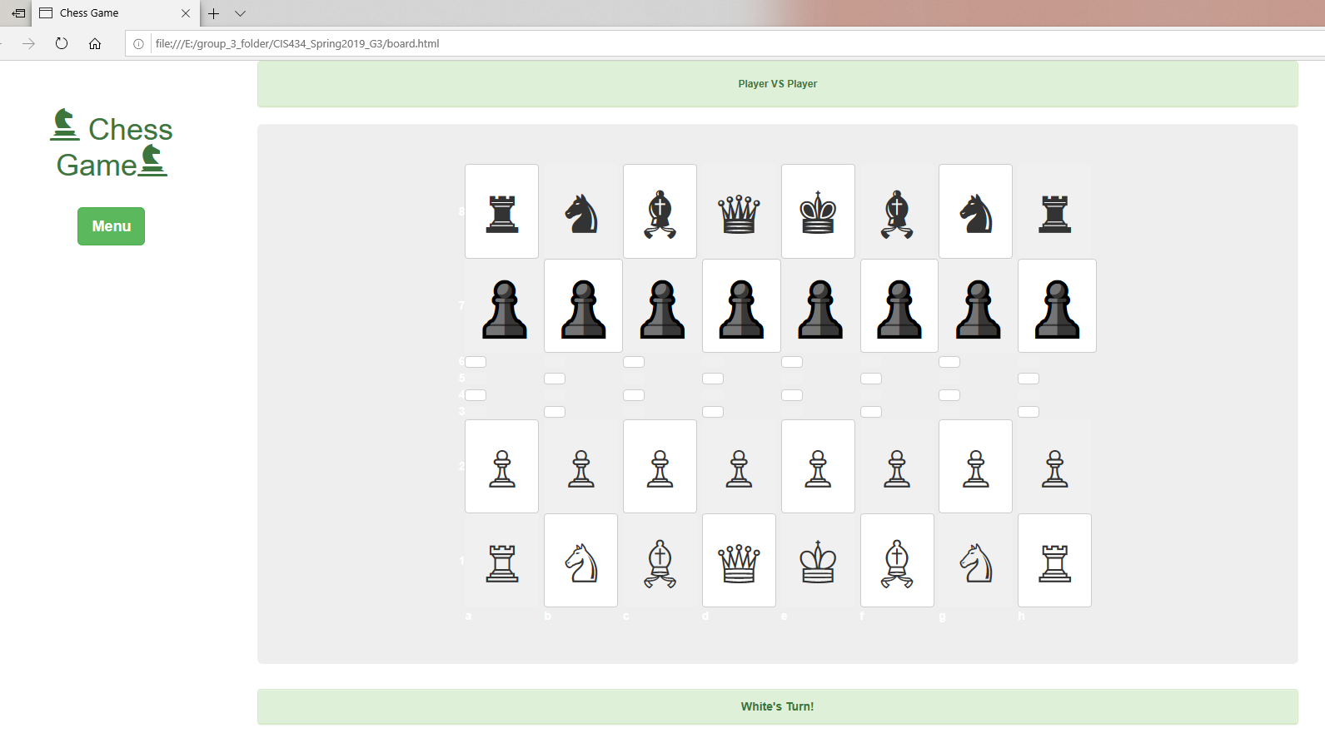
Prototypes and first approach
Original idea was to create 64 squares, and adjust the HTML container until we have 8 By 8 squares.
Issues
Very inefficient.
No interface to interact with code or user.
Extremely rigid and difficult to stylized with CSS.
solutions
9 by 9 borderless table.
Each cell will contain a button for interaction.
Button is stylized with CSS and made to look like a square.

Slide 11
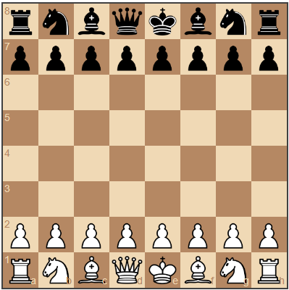
New issues and second approach
The UI design was not visually appealing .
Functional button placement (New game, dropdown) were not in alignment.
There was no overall structure.
After more research I found a JavaScript library that can embed a chess board in html.
But we could not ingrate it with our code.
I used this as a basis for my design.

Slide 12

Bootstrap
Bootstrap is a free and open-source CSS framework for responsive, front-end web development.
Bootstrap contains CSS and JavaScript design templates for typography, forms, buttons, navigation and other interface components.
Bootstrap allowed us to add a bit more flavor to the design, by integrating it with our html and tweaking each bootstrap component with CSS.

Slide 13
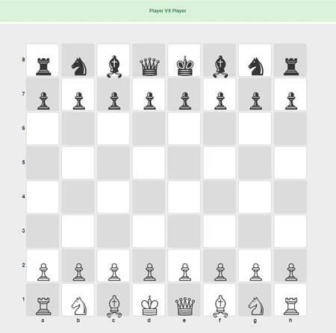
After bootstrap
There was more structure to the board, and considerable improvement but the still much to improve on.
This especially true with the position of the pieces on the squares.
*Note: The pieces are actually html Unicode characters.

Slide 14
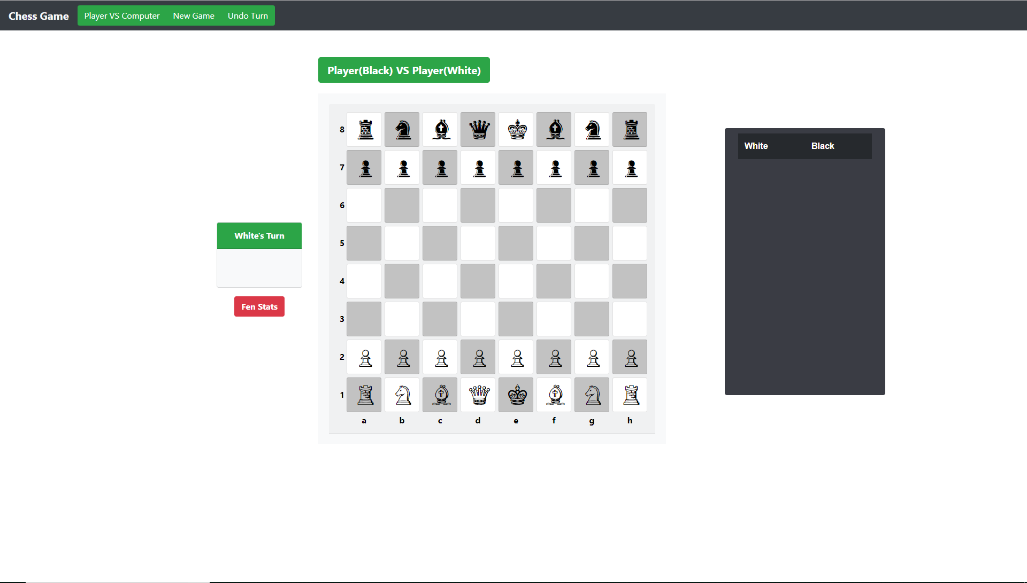
finally
With much tweaking and experimentation we where able to get a well structured board.
As well as a clean UI and user experience that highlight gray squares (yellow) and white (blue) when hovered over.
We also have a navigation bar for functional buttons that select new games and undo previous moves made.
A window to display movement log that is toggled by a button.
And a pane to show whose turn it is as well as the current game state.

Slide 15
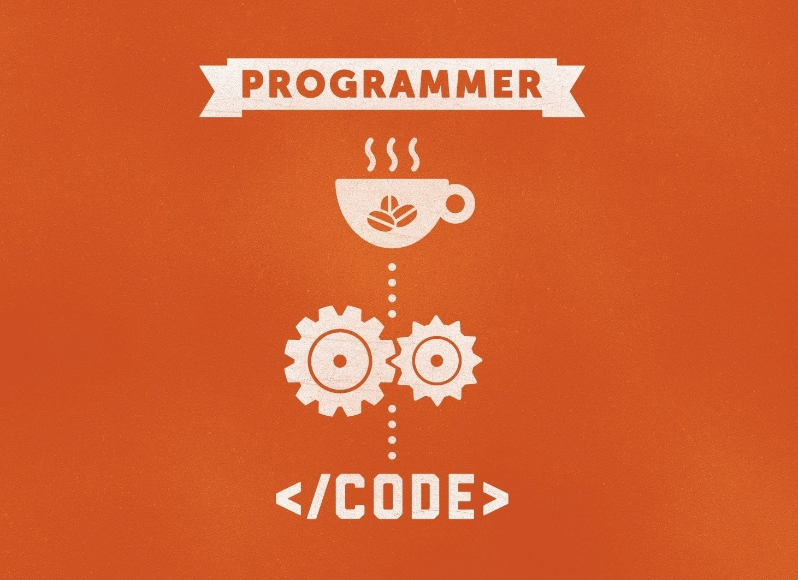
Game Logic

Slide 16
Design Concepts
Implement legal movements for each piece.
Implement special moves such as castling, en passant and pawn promotion.
Integrate AI (computer opponent).

Slide 17
Model-View-Controller
Developed naturally as a result of our requirement specifications.
There are 4 JavaScript files that handled different aspects of the game.
First there is chesspices.js to model the chess pieces on the board, and also function.js to model game state.
Movement.js is used to model the behavior of the chess pieces on the board.
The view is the html graphic aspect of the game.
Finally we have events.js which acts as the controller that handle all AI and player interaction with the interface.

Slide 18
Bugs and Issues:
Primarily from computing the current game state (i.e. check & checkmate).
Infinite loops resulting from faulty string parsing and Boolean logic.
Maintaining consistency in the data between functions.
Frequent adjustments to previous functions to better suit the needs of the newer ones.
Primarily focused on functional requirements over nonfunctional ones.

Slide 19

AI (computer opponents)

Slide 20
How chess ai works
When a human mind is exposed to something new, the initial trails of implementing the new knowledge contain many rounds of error. Early defeats are due to the human not recognizing certain configurations and having a lack of experience when it comes to different strategies and tricks
As the human practices, the skill develops
Chess is a game that requires higher level abstract thinking and to know board patterns all while thinking ahead of your opponenent.

Slide 21
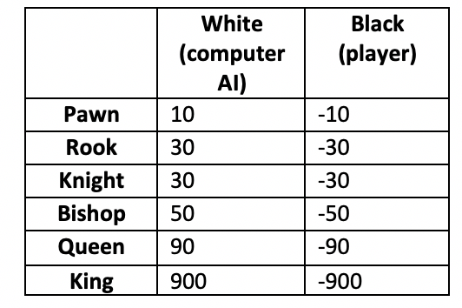
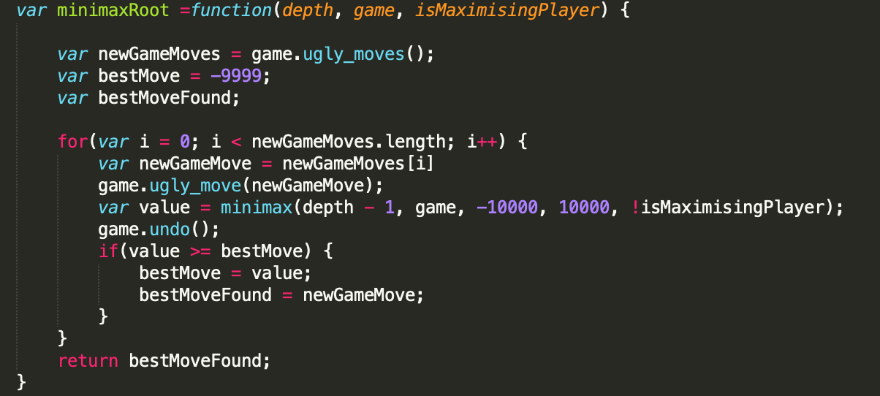
Position evaluation
After an initial algorithm that allows a game to be played is implemented, the computer needs to figure out what side is stronger in the current game state.
This allows the algorithm to choose the move that has the highest evaluation instead of choosing any on e of the possible moves at random.

Slide 22
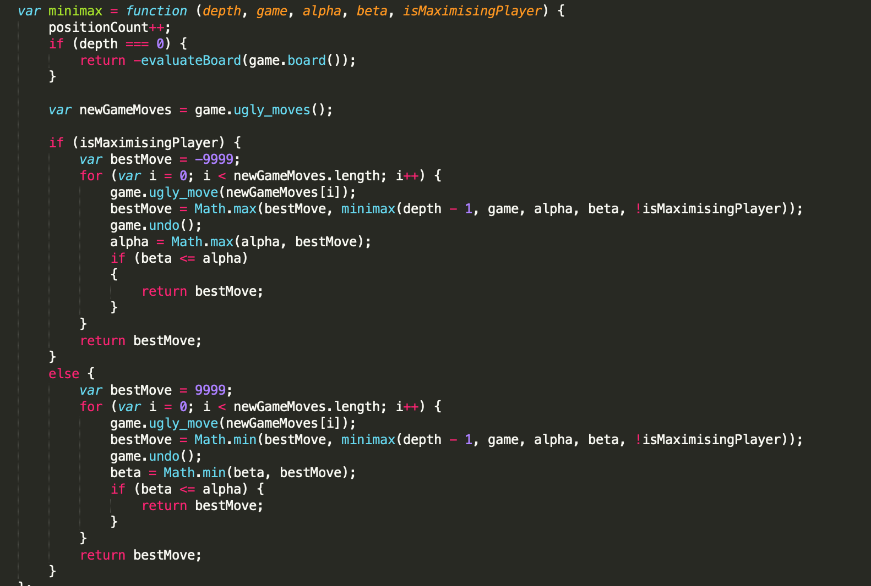
Search tree using minimax
It is assumed that both the computer and the human player will play the best moves.
A recursive tree of all possible moves is explored and the position is evaluated at the ending leaves of the tree.
The value of the child node is returned to either minimize or maximize the outcome at each level– this depends on whose move it is.

Slide 23
Search tree using minimax
The reason the minimax algorithm was chosen was because this backtracking algorithm is best suited for decision making and game theory.
The computer is able to search a game tree of all possible moves and counter moves, before evaluating each move and determining which is the best move on its turn, and the worst move when it is its opponent’s turn.

Slide 24
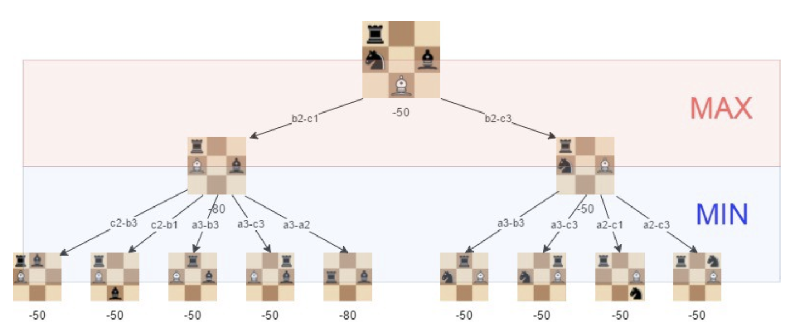
Position evaluation
The current state of the game is the root of the tree. (drawn at the top)
This node’s children representing all of the possible moves the computer can make.
Each of those nodes has children representing the game state after each of the opponent’s moves, and so on.
The leaves of the tree are the final state of the game– where no further move can be be made either due to a tie, or one player winning.

Slide 25

Additional algorithm implementation
If the computer is faced with only a few possible moves, the run time is low. On the other hand, if the computer is faced with a lot of options that it has to outweigh against each other possible outcome, it will take significantly longer for the computer to decide which possible move will be the most favorable given the current board state.
The ‘alpha-beta pruning” technique allows the computer to “prune” branches of the minimax algorithm search tree that yields less favorable results.
Given more time, this algorithm would help reduce run time further.

Slide 26
Questions?

